Slide 1
Predicting Spotify Song Genre
David Abelseth

Slide 2
Table of contents:
Compiling the dataset
Explanatory Data Analysis
Predictive Analysis
BUT FIRST – The guaranteed* 7 step process to creating a top 200 Spotify Track
*not actually guaranteed unless you are drake

Slide 3
How to make a top 200 Spotify Track
Step 1: Be Drake
Step 2: Lyrics – 100% of the observed top 200 track sample contained lyrics. Unless you’re writing the inception 2.0 soundtrack, stick to non-instrumental music.

Slide 4
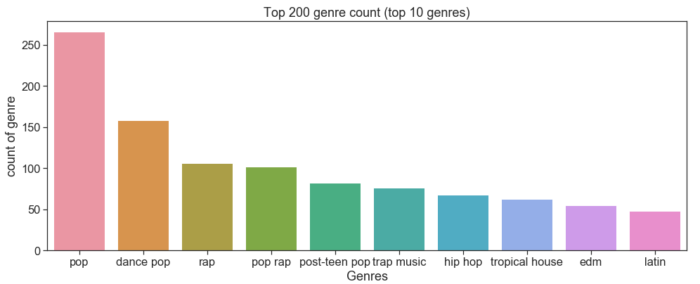
How to make a top 200 Spotify Track
Step 3: Stick to popular genres (pop, rap, edm, rock). Chances are, your Albanian death metal band is going to have a tough go to the top

Slide 5
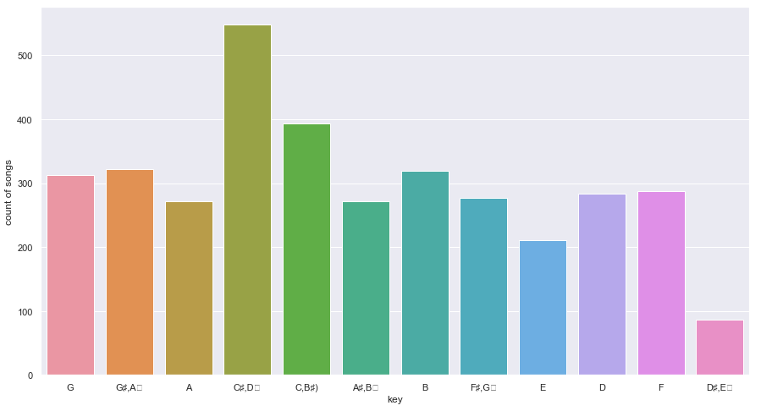
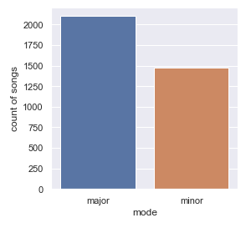
How to make a top 200 Spotify Track
Step 4: Write in C#/D♭, write in major scale (those white keys on piano)

Slide 6
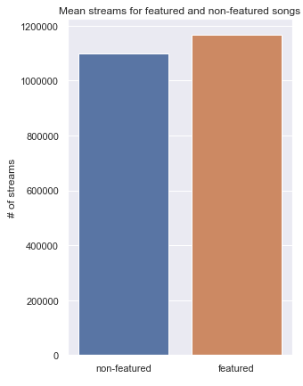
How to make a top 200 Spotify Track
Step 4: Feature AS many artists AS you can
Featuring another popular artist increases your stream numbers by a statistically significant amount

Slide 7
How to make a top 200 Spotify Track
Step 5: Do not break the cardinal rules for each genre
EDM – Do not make a song outside of 120-130 bpm¹ range
Rock – Make your music LOUD (much louder than other genres)
Rap – Words… lots of them and unique ones too!
Pop – The only rule to making a popular pop song is that there are no rules Happy songs, sad songs, fast/slow. Write in all the keys. Swear lots, don’t swear you get the idea
1 - bpm = Beats per minute

Slide 8
Compiling the dataset

Slide 9
Compiling the dataset
The data sourced for the project was pulled from the official Spotify API
The data was aggregated by scrapping the daily top 200 charts csv files (provided by Spotify)
Get request
Python Requests Library
Spotify API
CSV file
The API request was repeated for 850 days from January 1st 2017 to April 30th 2019

Slide 10
Compiling the dataset
Once the csv files were pulled, the files were aggregated using a helper function in pandas
+
=
Each daily top 200 stream csvs
850 days of top 200 stream numbers

Slide 11
Compiling the dataset
Dataset
Unique list of artists
Once aggregated into one dataframe, a list of unique artists was extracted
->This unique list of artists formed the basis for a large song search using the API

Slide 12
Compiling the dataset
Each artist in the ‘popular’ artist list was searched to find similar artists that did not “make the cut”
The API returns ~7 related artists. Compiling this list of similar artists increases the list to a total number of 4978 artists
Unique list of artists
Artist
Artist Search Spotify API
+
=
7 similar artists returned
737 artists - - - > 4978 artists

Slide 13
Compiling the dataset
The final song dataset was compiled by searching popular songs for the 4978 artists.
Along with the details of the song, features were also returned in the API request (tempo, key, duration etc.)
This final dataset will serve as the data for the genre classification model.
Artist Song Search Spotify API
4978 artists
44,146 songs & song features

Slide 14
Explanatory Data Analysis
To get a better sense of the layout of the dataset, the following questions were asked:
1) Does featuring another artist on a track correlate to higher stream numbers?
2) What kind of growth in stream numbers has Spotify achieved over the past two years?
3) What does the distribution of stream numbers look like for the top 200 stream list?
4) When do Spotify users tend to stream the most?
5) Who is the most popular artist/song in the last 2 years ?
6) What types of genres tend to be on the top 200 charts

Slide 15
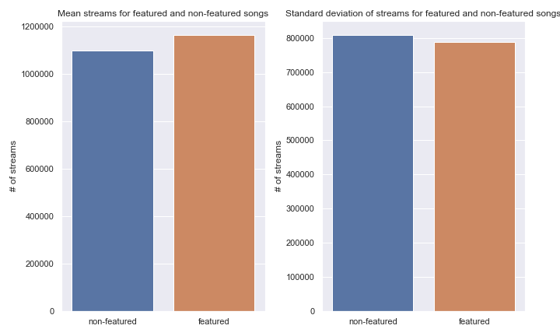
Explanatory Data Analysis
Does featuring another artist on a track correlate to higher stream numbers?
Yes, featuring another artist not only increases average stream count, but also more consistent in terms of variance.

Slide 16
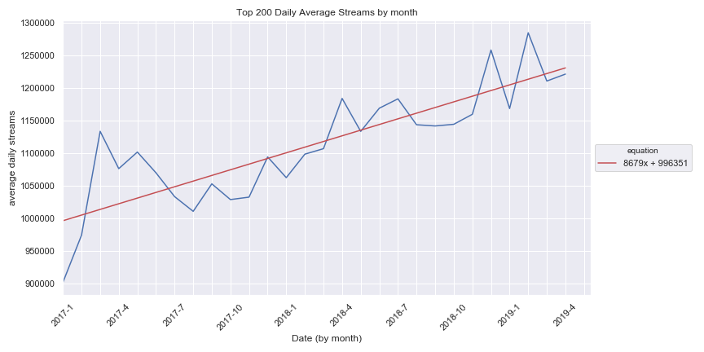
Explanatory Data Analysis
2) What kind of growth in stream numbers has Spotify achieved over the past two years?
Spotify has consistently been able to add an additional ~8,700 streams per month between Jan 1st 2017 to April 2019

Slide 17
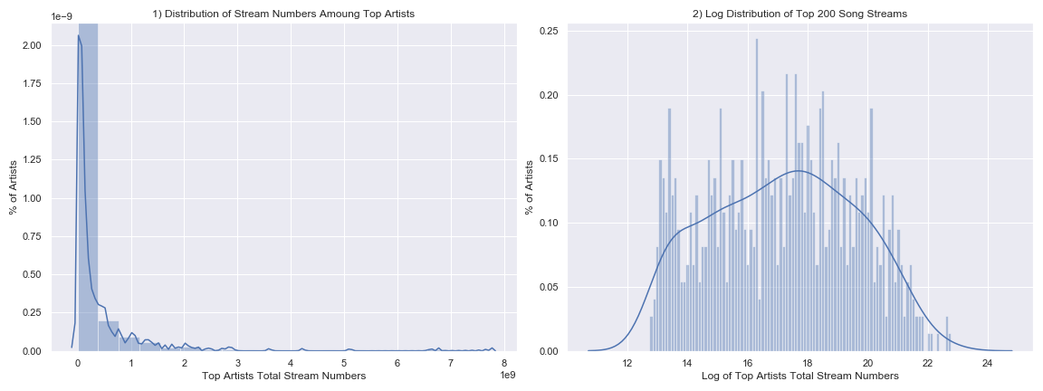
Explanatory Data Analysis
3) What does the distribution of stream numbers look like for the top 200 stream list?
In terms of stream count distribution, we see an exponential distribution where a few superstar artists make up most of the stream numbers.
Taking the log of the distribution, we see the distribution is normally distributed.

Slide 18
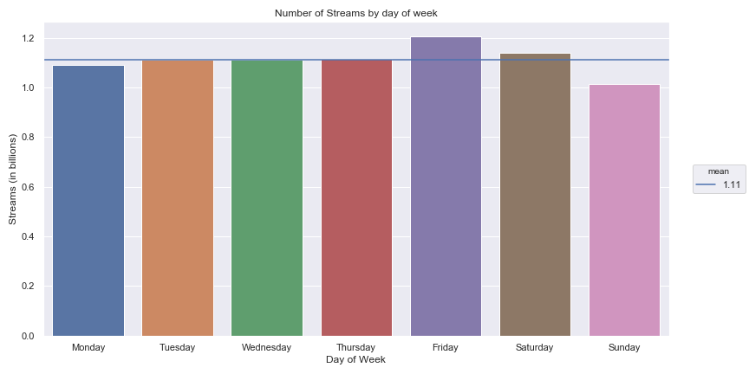
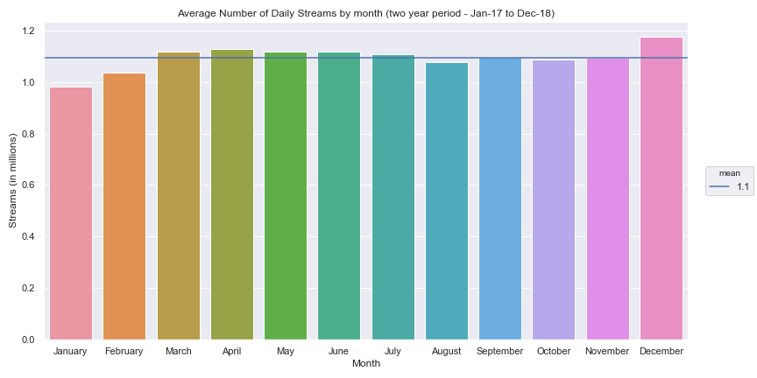
Explanatory Data Analysis
4) When do Spotify users tend to stream the most?
Spotify users tend to stream the most on Friday
Spotify users tend to stream the most in the month of December

Slide 19
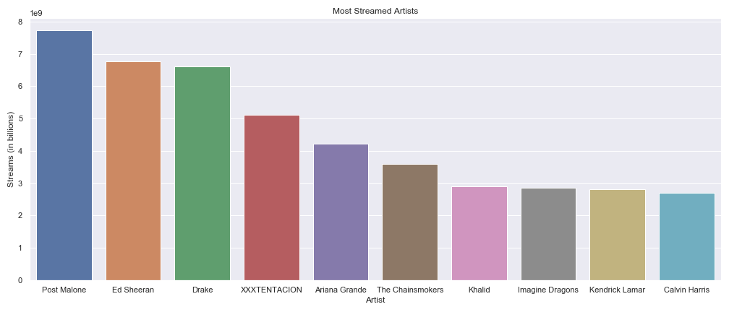
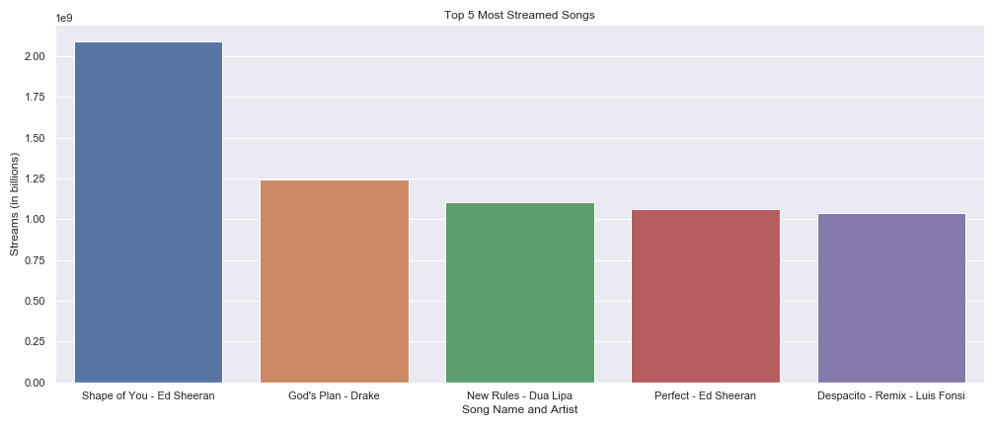
Explanatory Data Analysis
5) Who is the most popular artist/song in the last 2 years?
Post Malone is the most popular artist in terms of stream count
“Shape of You” by Ed Sheeran is the most popular song

Slide 20
Machine Learning
14 song features were used to classify common genres
duration_ms - The duration of the track in milliseconds.
Key - The estimated overall key of the track. Integers map to pitches using standard Pitch Class notation . E.g. 0 = C, 1 = C♯/D♭, 2 = D, and so on.
Mode - Mode indicates the modality (major or minor) of a track, the type of scale from which its melodic content is derived. Major is represented by 1 and minor is 0.
Time_signature -An estimated overall time signature of a track. The time signature (meter) is a notational convention to specify how many beats are in each bar (or measure).
Acousticness - A confidence measure from 0.0 to 1.0 of whether the track is acoustic. 1.0 represents high confidence the track is acoustic.
Danceability - Danceability describes how suitable a track is for dancing based on a combination of musical elements including tempo, rhythm stability, beat strength, and overall regularity.
Energy - Energy is a measure from 0.0 to 1.0 and represents a perceptual measure of intensity and activity. Typically, energetic tracks feel fast, loud, and noisy.
Instrumentalness - Predicts whether a track contains no vocals. “Ooh” and “aah” sounds are treated as instrumental in this context.
Liveness - Detects the presence of an audience in the recording. Higher liveness values represent an increased probability that the track was performed live.
Loudness - The overall loudness of a track in decibels (dB). Loudness values are averaged across the entire track and are useful for comparing relative loudness of tracks.
Speechiness - Speechiness detects the presence of spoken words in a track. The more exclusively speech-like the recording (e.g. talk show, audio book, poetry), the closer to 1.0 the attribute value. Values above 0.66 describe tracks that are probably made entirely of spoken words.
Valence - A measure from 0.0 to 1.0 describing the musical positiveness conveyed by a track. Tracks with high valence sound more positive (e.g. happy, cheerful, euphoric), while tracks with low valence sound more negative (e.g. sad, depressed, angry).
Tempo - The overall estimated tempo of a track in beats per minute (BPM). In musical terminology, tempo is the speed or pace of a given piece and derives directly from the average beat duration.

Slide 21
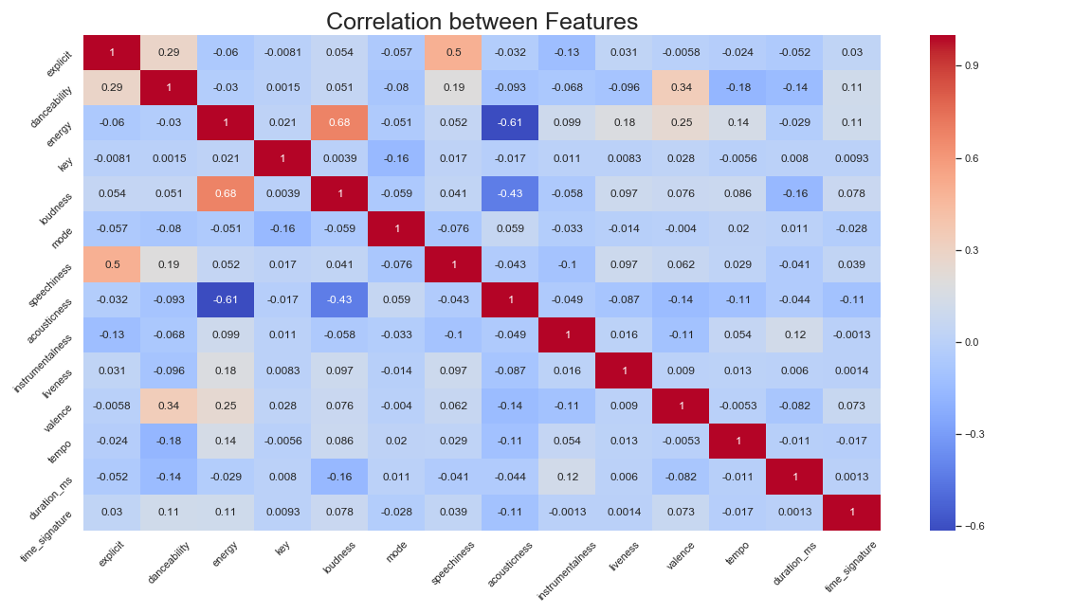
Machine Learning
A correlation matrix of the features was plotted to determine if there was any multicollinearity between the song features

Slide 22
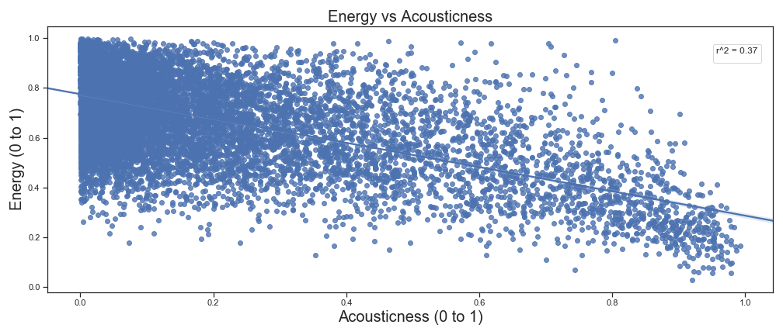
Machine Learning
For correlated features (such as Accousticness & Energy), a regression was run to determine if a feature could predict another.
If so, it would be a redundancy to include in the final model and would hurt the accuracy of the final model.
With a r² of 0.37, the two features are not correlated enough to hinder the accuracy of the final model

Slide 23
Machine Learning – predicting genre
To predict Spotify song genres based on the song features, the following models were fitted. The best performing model was then selected for hyper-parameter tuning
Random Forest
AdaBoost
One Vs Rest (Naïve Bayes, Logistic Regression, Decision Tree)
One Vs One (Naïve Bayes, Logistic Regression, Decision Tree)
Support Vector Machine
KNN

Slide 24
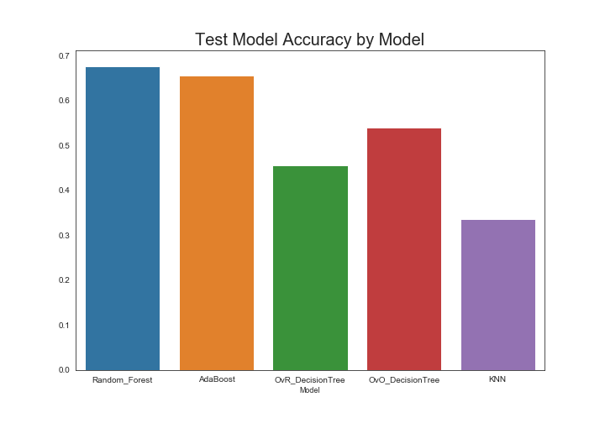
Machine Learning – predicting genre
Of the 10 total “out of the box” models tested, a Random Forest model performed the best in terms of overall accuracy.
The Random Forest model was selected for hyper-parameter tuning

Slide 25
Machine Learning – Improving Performance
To improve the overall performance of the Random Forest model, the following steps were taken:
A. Scaling the data
Using Sklearn standard scaler, the dataset was scaled to a mean of 0 with a standard deviation of 1. Model performance increased marginally (~0.1%) after scaling the data. This marginal increase is expected due to most of the data already being scaled between 0 and 100 by Spotify.
B. Dropping unnecessary features
The feature “Mode” was dropped due to the it’s feature importance being <~1%
C. Grid Search – Hyperparameter tuning and cross validation
Hyperparameter tuning was performed by using Sklearn grid search along with 4 fold cross validation and a holdout set of 25%¹.
1 – 25% CV was chosen due to the models ability to converge with a small subsection of the data

Slide 26
Machine Learning – Final Model
In determining the final model, The following parameters were used in the tuning.
bootstrap: True, False
max depth: 5,10,15,20,25,30
max features: 2,5,6,7,8,9,10,11
n estimators: 10,20,30,40,50,60,70,80,90,100
The final model was determined by fitting 2,880 models using the parameters above The optimal parameters for the model are as follows:
bootstrap: True
max_depth: 25
max_features: 2
n_estimators: 90

Slide 27
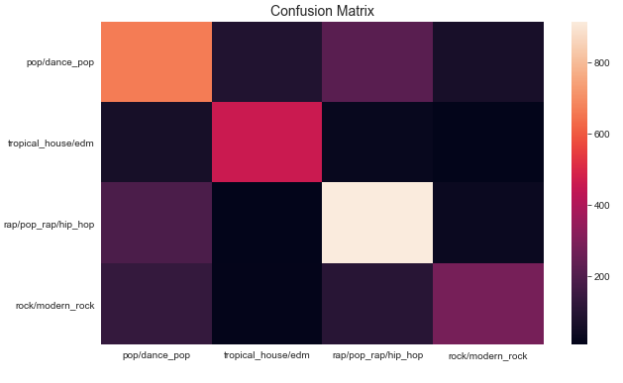
Machine Learning – Final Model
To determine how the overall model performed, a confusion matrix was plotted.
The overall (tuned) model performs at ~70% accuracy
Looking at the confusion matrix, the model has difficulty differentiating pop and rap music.

Slide 28
Final Thoughts
The song feature data from the Spotify API was able to predict common genres with an accuracy of 70%. While this is a decent result, the model can be improved further.
Additional features such as lyrics or song meta data (frequency, amplitude etc.) could improve the model as well as allow the classification of subgenres.
For example, the difference between modern rock and rock music could possibly be differentiable by a model with more data.
Finally, a more advanced model could potentially be used for the more nuanced data (such as frequency, amplitude etc.)
For example, a 1D convolutional neural network could potentially be leveraged to improve model accuracy by encapsulating time series data throughout the song.

